Slide 2
Team Overview
Advisors
Faculty Advisor
Dr. Kevin Cole
NAR/TRA Mentor
Thomas Kernes
Management
Project Director
Matthew Mahlin
Safety Coordinator Paul Kubitschek
Outreach Coordinator
Bryan Kubitschek
Team Leaders
Airframe Team
Paul Kubitschek
Avionics Team
Alyssa Koch
Payload Team
Alexandra Toftul
Propulsion Team
Sydney Schaaf
Mission
Design and build a launch vehicle to reach an altitude of 5,280-Feet AGL
Deploy Scientific payload
Recover all components in a reusable condition

Slide 3
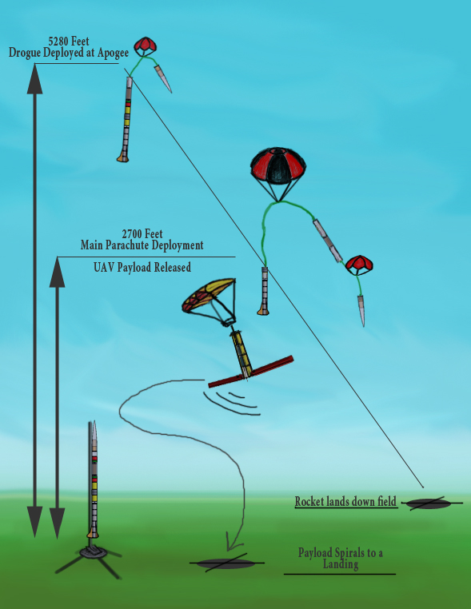
Mission Profile

Slide 4
Preliminary Design Discussion

Slide 5
Vehicle Overview - Deimos
Length: | 124.5”
Diameter: | 5.5”
Nose Cone: | 27.5” | Von Kármán (LD-Haack), 1:5 Fineness
Fin Span: | 14.5” | (3-fin configuration)
Weight: | 26.5 lbs | (No Motor – No Payload – Estimated)
Motor Mount: | 98mm | 37” long – rear retaining ring

Slide 6
Stability Characteristics
OpenRocket Model
Will need to be verified

Slide 7
Plans for Vehicle Safety
Risk | Consequence | Precautionary Measures
Contact with Hazardous Chemicals and Materials | -Bodily Injury: Irritation, burns, and allergic reaction -Work stoppage | -Material Safety Data Sheets of all hazardous chemicals and materials will be available to and reviewed by all members. -Facilities with fume hoods will be used for caustic materials. -Protective equipment including, but not limited to, gloves, safety glasses, and filtered face masks.
Misuse of Power Tools | -Bodily Injury: Cuts, Abrasions, and Bruises -Work stoppage | -Instructions will be given prior to student use of equipment. -Experienced technicians or upper classmen must be present for all machining.
Unintentional Ignition of Igniters or Electric Matches | -Bodily Injury: Minor Burns -Fire -Lose of critical supplies | -All electric matches will be shorted together at their ends. -Proper storage in secure grounded case
Unintentional Detonation of Black Powder | -Bodily Injury: Serious Burns, and hearing loss | -Ejection charges will be filled last with flight computers deactivated. -Handlers will wear work gloves and Ear Plugs.
Unintentional Ignition of Motor | -Bodily Injury: Serious Burns, Bruises, Loss of Life -Cancellation of Flight -Property Damage | -All motors stored unloaded without igniters. -Prepared motors will not be loaded with igniters until mounted on pad. -Loading must be supervised or performed by Certified personnel.
Component Damage Through Testing | -Increased costs -Project Delays -Redesigns | -Grounded equipment used when handling sensitive electronics. -Wearing necessary and precautionary safety equipment. -Only required personnel allowed in proximity to components during testing. -Checklists utilized to ensure proper procedures during operation.
Launch and Recovery Problems | -Loss of Vehicle -Loss of Payload -Serious Bodily Injury or Death -Property Damage | -Following TRA/NAR Safety Code -Use of checklists. -Cancellation of Launch in event of adverse weather conditions. -All personnel must be at safe distance before ignition system is armed.

Slide 8
Launch Characteristics
Candidate Motor
Aerotech L1120W-P
75mm motor
Simulation Parameters
12 foot guide rail

Slide 9
Functional Requirements
System | Subsystems | Functional Requirement
Nosecone | Primary System Communications Array | -Reduce drag force -Must not deform under flight loading -House communications array -Mount drogue parachute -Couple with Sustainer -Transmit GPS location to Ground Station
Sustainer Assembly | Primary System Recovery Systems Avionics Bay | -House recovery and avionics bays -Must not deform under flight loading -Couple to Nosecone -Couple to Booster -House Drogue Parachute -House Main Parachute -House Payload -House Flight Computers -Mount Ejection Charges -Allow external access -Mount both parachutes to bulkheads
Booster Assembly | Primary System Fins Motor Mount Tube | -House motor mount tube -Fin Mounting -Couple to Sustainer -Must not deform under flight loading -Transfer fin moment -Stabilize vehicle for flight -Must not deform under flight loading -Transfer axial motor thrust load -Mount Parachute to Engine Block -Retain motor -Allow quick installation of motor

Slide 10
Launch Vehicle Verification
Subsystem | Test Plan | Verification Metric | Target Date
Altimeter Accuracy | -Subscale Test flights | -Agreement between altimeters | January 2012
Recovery System Deployment | -Ground Simulation -Test flights | -Components ejected forcefully -Visually confirm deployment -Vehicle recovered intact | December 2011
Tracking Equipment | -Ground distance test -Test flights | -Line of sight transmission at least 1 mile -Successful tracking after launch | January - March 2012
Motor integration | -Test fit -Fit adapter if needed | -No shifting of motor -Motor housed internally | January 2012
Altitude | -Full scale test flight for both candidate motors -Add ballast as needed | -Compare recorded altitudes with that of simulations | February – March 2012

Slide 11
Vehicle System Overview

Slide 12
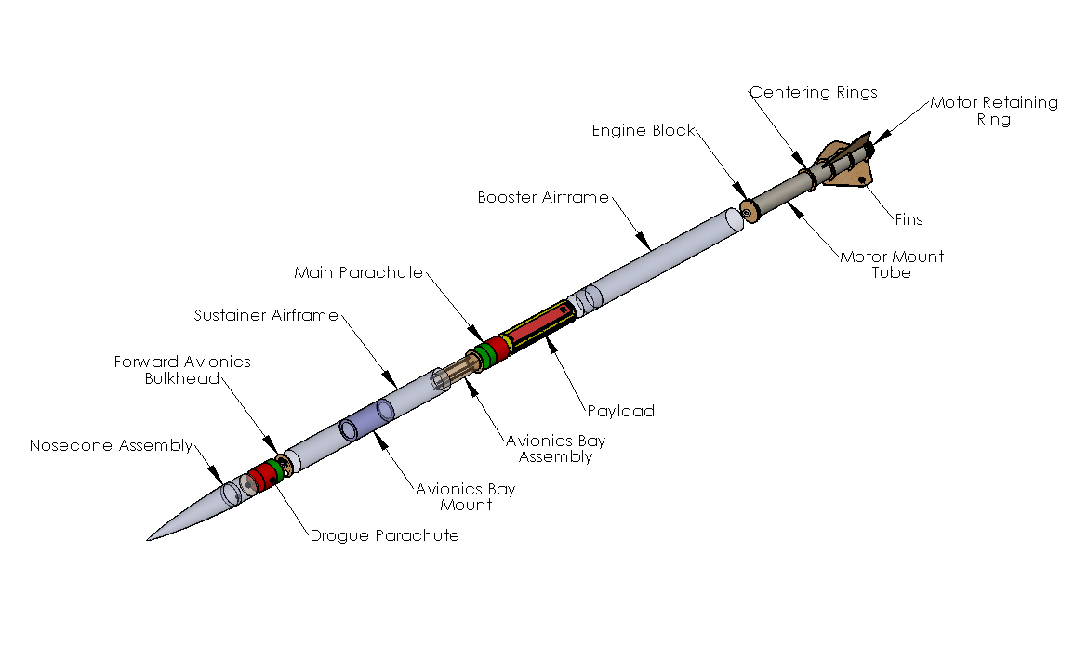
Assembly

Slide 13
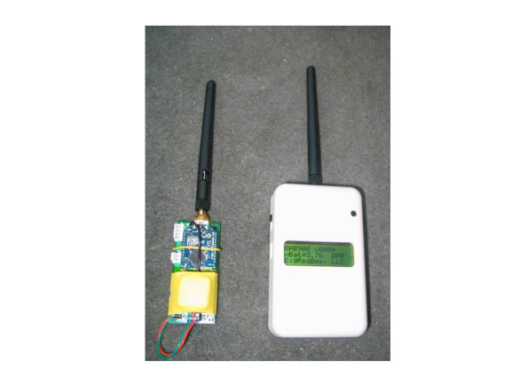
Nosecone
Characteristics
Von Kármán (LD-Haack)
1:5 Fineness
Communications
GPS Transmitter
Antenna

Slide 14
Sustainer Assembly
Components
Avionics bay Mounting
Side Hatch
Material
Blue Tube
Fiberglass (8oz)
Glass Sock
Dimensions
Length - 48 in
AV bay length - 12in

Slide 15
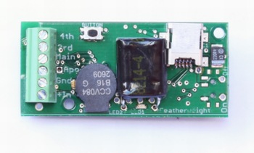
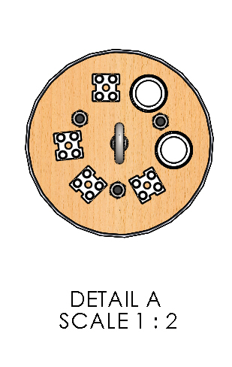
Avionics
Components
Perfectflite StrattoLogger
Featherweight Raven
Concept of Operation
Access from Side hatch
Activated by external key switches
Primary charge fired by both altimeters
Secondary charge fires 5 seconds later by Raven
LiPo
Raven
StrattoLogger
LiPo

Slide 16
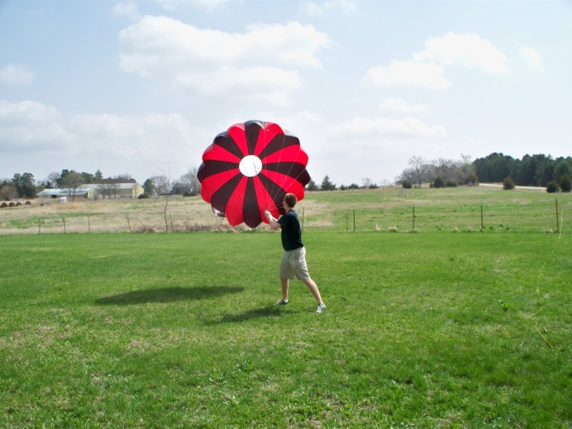
Recovery
Components
Mounting
Nosecone Tethered to Sustainer
Sustainer Tethered to Booster
Forged U-Bolts
Concept of Operations
Drogue @ Apogee
Main @ 2,700-Feet
Component | Characteristic Dimension | Comment
Main Parachute | 108” | 27ft/s descent rate, 24” Spill hole
Drogue | 24” | 130ft/s descent rate, X-Form
Shock Cord | 52’ | 1” Tubular Nylon
Nomex Wadding | 24” | Fireproof protection

Slide 17
Booster Assembly
Components
98mm MMT + Retaining Ring
Fins x 3
Coupler
Material
Blue Tube
Fiberglass (8oz)
Glass Sock
Dimensions
Length 48 in

Slide 18
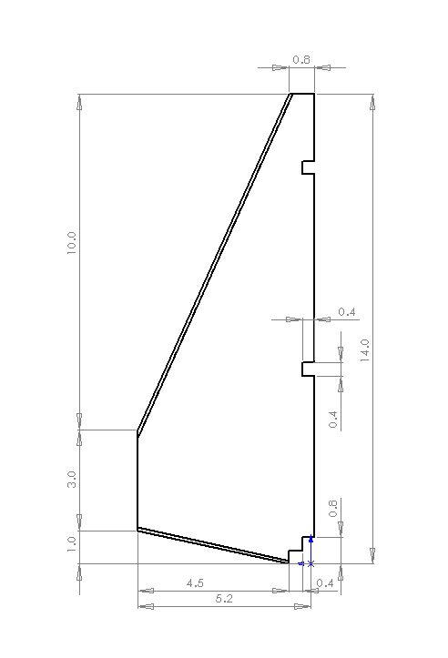
Fins
Material
5mm thick Tri-Plywood
Fiberglass
Vinyl Ester Resin
Construction
Laser cutting
Hand sanding
Vacuum Bagging
Assembly
Mounting to MMT
Bond to booster
Tip to tip

Slide 19
Scientific Payload Discussion

Slide 20
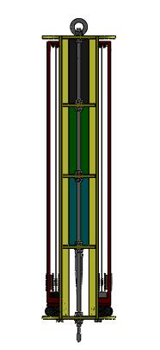
Baseline payload design

Slide 21
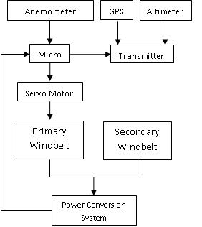
Baseline payload design

Slide 22
Subsystem | Pre-Flight Test Plan | Verification Metric | Target Date
Payload Airframe | Drop test | Visually verify wind deployment | February 2012
Primary and secondary windbelt systems | Detect induced voltage in coils Airspeed/resonance relationship | Voltage detected in coil > 30mV and exhibits period structure (not noise) | December 2011
Active windbelt tension control system | Interface micro with servo/belt Interface micro with anemometer | Frequency of voltage waveform = expected frequency for known wind speed | January 2012
Sensors and transmitter | Compare sensor data to know values Transmit data | Sensor output values (received data ) w/in 1% of known values (transmitted data) | January 2012
Power conversion system | Input several AC waveforms and verify DC conversion/smoothing via scope Measure via micro and compare to scope value | Visually verify smoothed DC waveform/micro measurement w/in 1% of scope measurement | February 2012

Slide 23
Activity Plans

Slide 24
Major Milestone Schedule
28 November 2011 | PDR report due
 | Begin construction of UAV
 | Finish construction of UAV
 | Begin testing of UAV systems
5-16 December 2011 | PDR Presentation
 | Evaluate necessary design changes
 | Finish construction of Rocket
 | Complete testing of ejection system
January 2012 | First Test Launch
 | Visit local Schools (Park Middle School)
 | Verify Altimeter Accuracy and Agreement
23 January 2012 | CDR report due
1-10 February 2012 | CDR Presentation
February 2012 | Second Test Launch
 | Choose competition motor
26 March 2012 | FRR report due
2-11 April 2012 | FRR Presentation
19-20 April 2012 | Flight hardware and safety checks
21 April 2012 | Launch Day
7 May 2012 | PLAR due

Slide 25
Budget

Slide 26
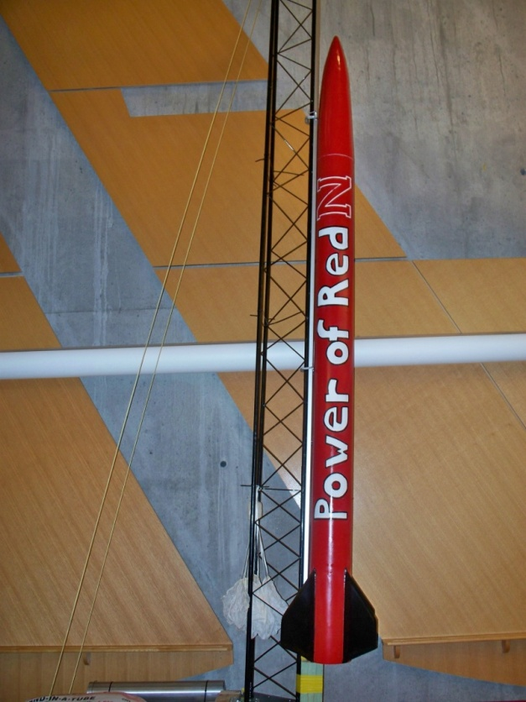
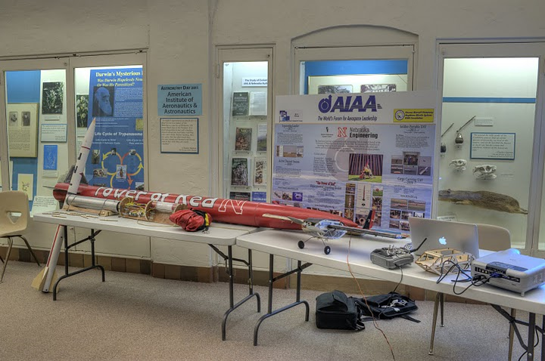
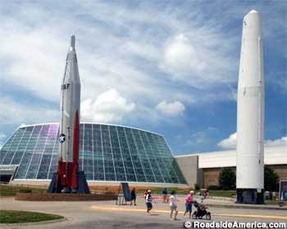
Outreach
Previous Activities
Engineering Week
Astronomy Day
Lockheed Martin Space Day
Current Collaborations
Water Rocketry
Demonstration
Construction
Launch

Slide 27
Questions?

